Slide 1
Welcome to VISA 101
(Engineering Edition)

Slide 2


Slide 3
r2
r1

Slide 4
r1
r2

Slide 5


Feedback function?
G
H

Slide 6
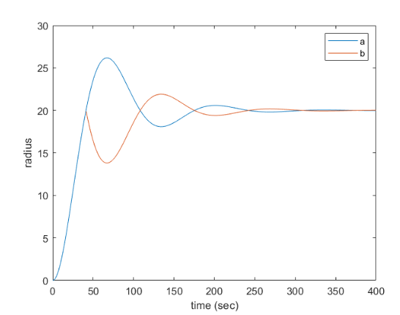
Major axis growth
a
b

Slide 9


Slide 10
What other functions do we seem to ‘just know’?

Slide 11
Thank u

